Slide 1
Workforce Systems of Record
Internal Use Only
Presentation to Andi Karaboutis

Slide 2
Executive Summary
Internal Use Only
Following the Group Data Strategy presentation to ITLT on 24th June a request was made to report back on the source systems, specifically for Workforce Data, the current challenges today and how the Group Data Strategy will tackle and resolve these issues.
A deep dive was completed on the Workforce Domain in 2020 that identified three major challenges:
Challenge | Proposed Solution | Solution Status
Lack of master data source for workforce | Establish golden master record Combine and share data from Master Data Management into Enterprise Data Platform | Workforce Data Domain Project (Start-up end July) and Global Workforce Tracking Project (On Hold)
Data quality issues, lack of trust ; misunderstanding of data | Data Quality reporting and ongoing business ownership of data | Workforce Data Domain Project (Start-up end July)
Headcount reporting issues across HR and Finance systems | The above solutions will help, plus, better controls over downstream data interfaces and improved report/data training | Raising awareness through training and education, supported partially through Workforce Data Domain project
Additional Support Required:
The Global Workforce Tracking Project remains on hold
Wider Enterprise approach to raise reporting/data understanding

Slide 3

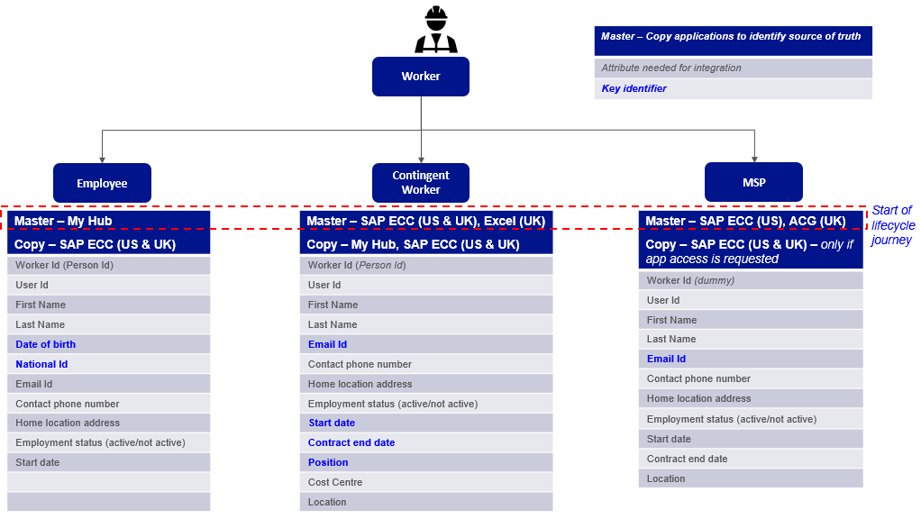







Master Data Management
Internal Use Only
Today in the absence of Workforce master data and accompanying data solutions it is difficult to report and manage total workforce numbers accurately and consistently
Multiple Data Repositories and Data Consumption Channels
No Golden Master Record
Employees & US Contingent Workers
UK Contingent Workers
MSPs
MyHub
SAP ECC (UK)
ACG (UK)
SAP ECC (US)
Solutions:
Consolidate master sources, remove manual processes and create consolidated data platform and reporting solutions
Golden master record definition fully implemented improving data quality and minimizing reporting errors

Slide 4
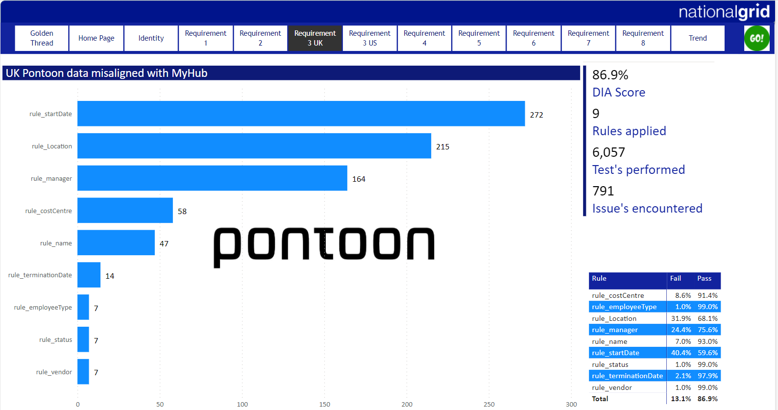
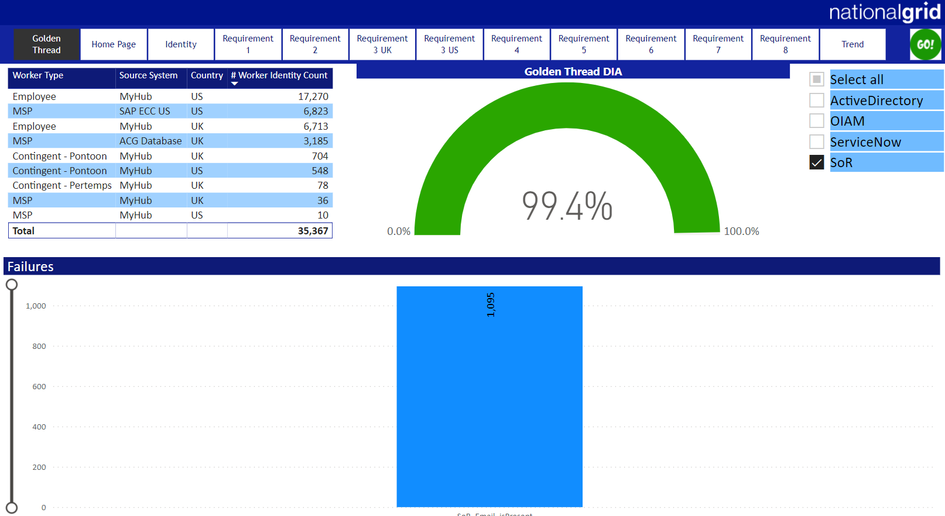
Data Quality Management
Internal Use Only
Progress has been made over the last 12 months in reporting and improving data quality; however some issues are still being resolved manually leading to lack of trust in the data and consequently perception of data issues
An example of the UK Contractor DQ report – MyHub v Fieldglass
8.6% (58 Contactors) have inaccurate or misaligned cost centres
42.5% (286 Contactors) have inaccurate start and termination dates. 24.5% (164 Contactors) have an invalid or missing Manager
The Golden thread DQ completeness score and data alignment across various platforms for Worker focused on 5 data points;
Worker id, Worker name, Status, Username, Email address
We now need to progress on the validity of the data within the fields
Solutions:
Workforce Data Domain project will; catalogue data and apply quality thresholds, introduce comprehensive quality reporting and ongoing data governance

Slide 5
HR versus Finance Headcount Differences
Internal Use Only
Today business users complain our total workforce numbers do not align between our HR and Finance systems and find it hard to report on them
Example – Org (MyHub) hierarchy
Example - Cost (SAP) hierarchy
We have an absence of agreed common definitions, ie:
Head count
“Count of the number of people who work in the organization at a particular point in time; including employees and contractors but not managed service providers”
FTE – Full time equivalent
“Refers to a unit of measurement based on the total number of hours worked that shows how many full-time equivalent employees in the organization at a particular point in time; across employees, contractors and some managed service providers”
I&O
I&O
686
163
1
20
121
48
13
124
14
71
86
498.9
118
24
10
30
42.9
6
92.8
127.5
47.7
IT Operations
IT Operations
Network Infra Services
Networks
End User Experience
End Use Services
Cloud & Hosting
Cloud & Hosting
Differences in how we manage heads / FTE not always known:
Timing ; figures will vary based upon point in time they are taken
Process ; centralised costs but organization aligned heads
Standards ; Finance org structure different to HR org structure
Data errors ; Incorrect employee data e.g. cost centre, organization unit
IT Commercial
Commercial
Global Infrastructure, Audit & Controls
IT Subscription
Strategy, Performance & Infrastructure Solution Delivery
Program Delivery
Strategic Business Relationship Management
CNI
Solutions:
UK CNI
I&O Management
Workforce master data, data quality and a trusted source of HR reporting (Enterprise Data Platform) will help. Downstream interface controls are required and improvements in report/data user training.
US CNI

Slide 6

Workforce Data Improvements
Internal Use Only
The Workforce Data Domain & Global Workforce Tracking projects will deliver key products to address majority of these challenges; Single data repository, Master Data, DQ reporting, Data Governance and Data Insights
Additional Support Required:
Data Ownership and Governance needs ongoing sponsorship
Wider Enterprise approach to raise reporting/data understanding
Process re-engineering to support data quality improvements at point of capture
Incentivise Data Stewards to work on data quality initiatives
Employees & US Contingent Workers
Contingent Workers
MSPs
MyHub
SAP ECC (UK)
ACG (UK)
SAP ECC (US)
FieldGlass
Master Data
Golden Record
Policies & Procedures
CDP
Data Management
Glossary
Catalogue
Data Quality
Data Modelling

Slide 7
How MDM helps Workforce data domain?
Current State
Future State
Employees & US Contingent Workers
UK Contingent Workers
MSPs
Employees & US Contingent Workers
UK Contingent Workers
MSPs
MyHub
SAP ECC (UK)
SAP ECC (US)
ACG (UK)
MyHub
SAP ECC (UK)
SAP ECC (US)
ACG (UK)
Master
Transaction
Master Data
Management
Master
MDM
CDP
Lack of single master data source for all workforce, due to multiple source systems
120+ direct interfaces from workforce source systems causing significant impact to business processes and transformational projects such as MyHUB 2.0
Headcount reporting issues across HR and Finance systems
Consolidate master data from multiple source systems
Golden master data record definition will help improve data quality
Reduce complexity for downstream extracts/interfaces
MDM provides ability to create downstream single version of truth for reporting

Slide 8

Internal Use Only
Appendix

Slide 9
Reltio Contract for Master Data Management SaaS
Why Reltio? A BCG study in 2020 identified gaps in National Grid’s control of data and recommended investment in a number of areas including a master data solution.
Reltio has been chosen as the master data management (MDM) solution following a market evaluation and sourcing exercise that looked at the following industry leading products: Reltio, Informatica, Enterworks, and Riversand. Reltio achieved the best combined technical and security results, and with a price $2.6m lower than Informatica, was clearly the best economic choice
What are we going to buy? National Grid is procuring a SaaS MDM solution that will connect data from multiple platforms to create and maintain consolidated master golden data. The system will be configured to support existing UK and US needs with plenty of room for growth. This includes licensing for all needed user roles, supporting Test, Development and Production instances for each of the US and UK.
Service: The service provides 99.95% availability SLAs with service credits for failed SLAs. Support covers both UK and US 9a-5p support
Disaster recovery: Disaster recovery follows ISO 22301 standards, and provides for global redundancy with nodes across a minimum of three cloud zones, including multiple servers within a zone. Data is replicated, load balanced and runs active-active across all zones enabling application and data resilience as well as improved scalability. Reltio’s BCP plan is also ISO22301 compliant with processes that address application & database outages, fires, pandemics, natural disasters & data breaches.
Contract: The terms represent a three year agreement and covers:
Termination for material breach / bankruptcy
Termination for convenience, with the possible responsibility for the full term contract price
Price $2.3m for 3 years (a $1m reduction negotiated against initial proposal)
Price increase capped at 4% for renewal beyond the 36 months
Contract negotiated but not signed

Slide 10

How MDM helps Workforce data domain?
Current State
Future State
Employees & US Contingent Workers
UK Contingent Workers
MSPs
Employees & US Contingent Workers
UK Contingent Workers
MSPs`
MyHub
SAP ECC (UK)
SAP ECC (US)
ACG (UK)
MyHub
SAP ECC (UK)
SAP ECC (US)
ACG (UK)
Master
Transaction
Master Data
Management
Master
MDM
CDP
Data Steward
Lack of single master data source for all workforce, due to multiple source systems
120+ direct interfaces from workforce source systems causing significant impact to business processes and transformational projects such as MyHUB 2.0
Headcount reporting issues across HR and Finance systems
Consolidate master data from multiple source systems
Golden master data record definition will help improve data quality
Reduce complexity for downstream extracts/interfaces
MDM provides ability to create downstream single version of truth for reporting
Legend
Source Systems
Workforce data entry
One directional data flow
Bi-directional data flows
MDM/CDP
Downstream Systems
BI Reports
Extracts

Slide 11

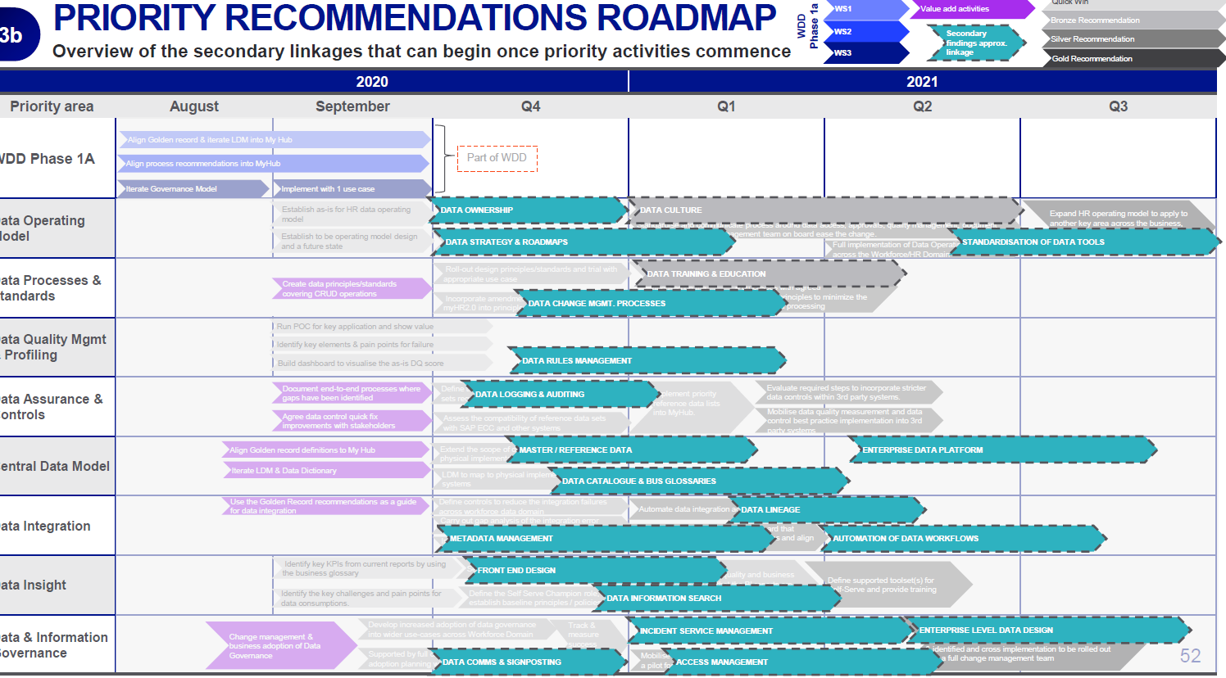
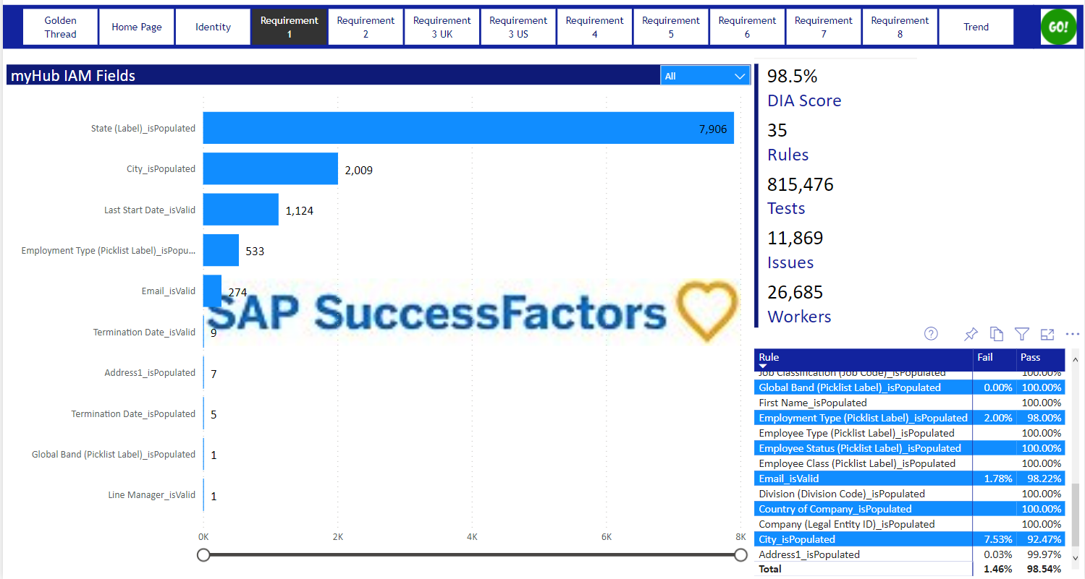

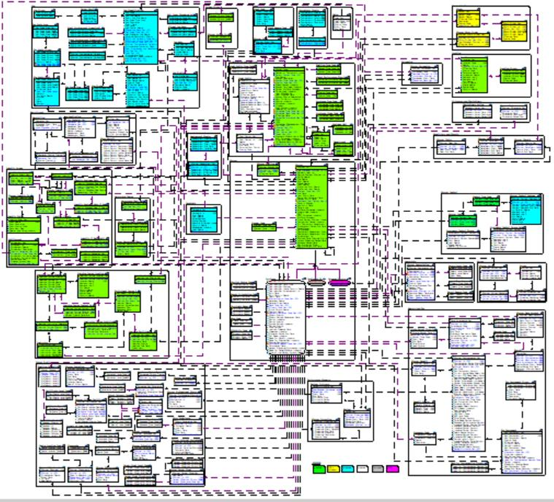
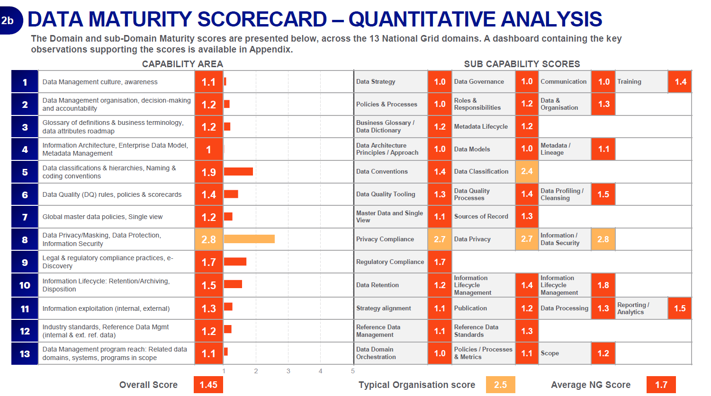
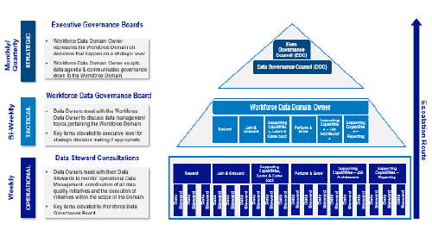

What’s been done
Internal Use Only
Domain vision, strategy, roadmap and business case
DQ reporting / Manual DQ remediation
Logical & conceptual data model established
Domain maturity baselined & Governance model built
Data use cases / Pain point identified

Slide 12
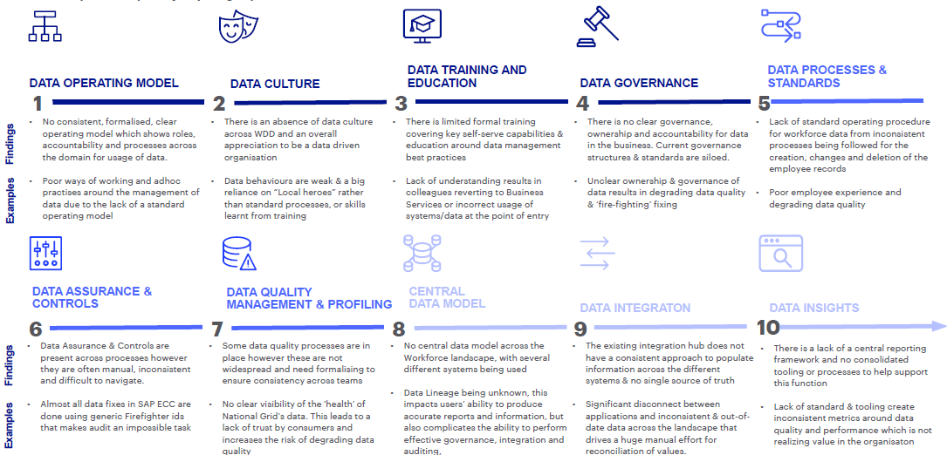
Workforce Data Domain Findings
Internal Use Only
A deep dive was completed on Workforce Domain in 2020 with the following opportunities identified and a roadmap developed to implement changes in parallel with MyHub 2.0:

Slide 13
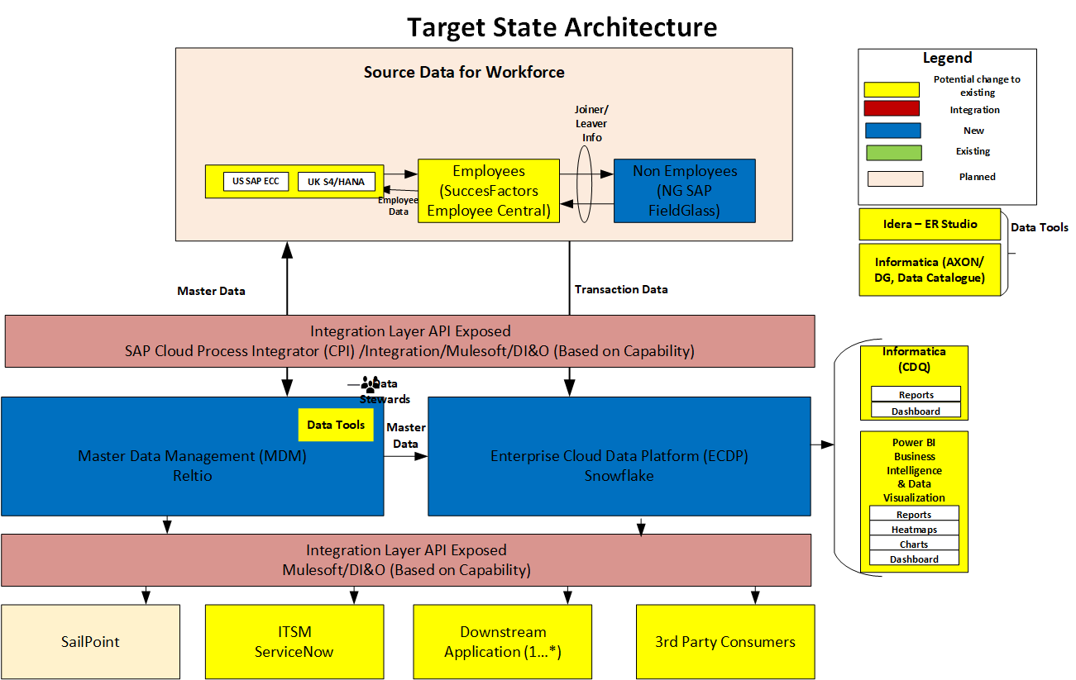
Future State Architecture
Internal Use Only

Slide 14
Future State Architecture
Internal Use Only

Slide 15

Workforce Data Domain Proposed Roadmap (Draft)
Internal Use Only
Delivery / Value Streams:
IAM
Workforce Data Domain (WDD)
2021
2022
May
Jun
Jul
Aug
Sep
Oct
Nov
Dec
Jan
Feb
Mar
Apr
May
Jun
Jul
Aug
Sep
Oct
Nov
Dec
Releases:
(WDD Phase 1)
MVP Release 1
(WDD Phase 2)
MVP Release 2
(WDD Phase 3)
MVP Release 3
MDM Tool
MDM tool
Ready to use
Data Integration
IAM Tactical MDM Solution with Unique Worker Persistent ID
Deep dive Integration issues
Impact analysis of ~140 workforce interfaces
Retire/replace IAM Interim MDM Unique Worker Persistent ID Generation
Transition and retire IAM Interim MDM Solution
Implementation of data integration improvements
Consolidated systems and interfaces Architecture View
Integration improvements to Downstream systems are driven from Golden Record recommendations
Implementation of data integration improvements
Alignment with Data Governance as an enabler for levels of communication
Enterprise data model and data glossary in ER/Studio
Alignment with Data Governance as an enabler for levels of communication
KPIs and information ready to be consumed in a consistent approach (use of a CDP solution).
Data Linage & Data Glossary in Informatica Data Catalog tool
Implementation of data integration improvements
MDM and CDP detail
Roadmap
Alignment with Data Governance as an enabler for levels of communication
Pre-work
MDM/DQ/DG
Workforce Data Governance
Business Rules/Requirement
Data Catalog, DQ Program
Unique Worker Persistent ID (leverage Tactical IAM MDM) , Key Worker & Position fields,
Org hierarchy, Cost Center, Location, Union, Legal Entity,
Vendor, Work order
CDP (Snowflake)
MDM Worker Persistent ID, Key worker fields, Position Data Sync
MDM Org hierarchy, Cost Center, Location, Union, Legal Entity,
Vendor, Work order Data Sync
SF Training, Competencies, Performance Measure Data Sync
Note:
All Timelines are subject to budget approval
Scope of each release will be finalized as per pre-work findings
Future Release timeline will be changed based on the current release date change
Notes:
Bottom-up view of enabling Data Capabilities in support of prioritized business capabilities
- Iterative approach to building out capabilities incrementally though data enablement – Clean data available and under management - Master Data managed under MDM and both Master and Transaction Data Available within the Data Hub
Business Capabilities sequencing and timelines are still subject to Top-Down Analysis under the Program Governance & Alignment and Technology Solutioning Towers (taking place over the next 3-4 months, but subject to funding)
- Programs need to re-align priorities and release plan, cross-program gaps and dependencies need to be revisited and programs must be funded and resourced accordingly. This is especially impacted by program gaps in CRM and Automated
Marketing capabilities
- Note: CRM and Marketing Automation Completes in Dec 2022
Timelines for many of the required business capabilities extend beyond May-2022 which are being driving by process and tech changes
Some Capabilities that the Blueprint suggests will be dependent on a step change in platform can begin to be enabled by a Step change in data (e.g. Billing Insights). Other such as (New Service Connect) will obviously be clearly be dependent on AMI service

Slide 16

Internal Use Only
What is a Worker?
Worker
A person linked to a POSITION in an ORGANIZATION (employee, contingent) or having a IT network identity (MSP)
Contingent Worker
Employee
MSP
Contingent work, casual work, or contract work, is an employment relationship with limited job security, payment on a piece work basis, typically part-time that is considered non-permanent. Contingent workers are provided to NG by MSPs that act as agents. NG pays the agent and the agent pays the worker.
Employees have a contract of employment and get paid directly by NG. Permanent employees do not have a predetermined end date to employment. In addition to their salaries, they often receive benefits like subsidized health care, paid vacations, holidays, sick time etc.
A Managed Service Provider (MSP) is a contingent and/or statement of work service implemented by an external organization that combines process, personal expertise and technology to support an organization’s gig, temporary, temp-to-hire, direct hire, independent contractor administration, Statement of Work (SOW) hiring and other complex services such as vendor management.

